Slide 1
On the Care and Feeding of Storage Devices
Benjamin Brewster

Slide 2

Why You Need to Care
Because someday you’ll have to:
Compare them and make a wise purchasing decision - pick the right tool for the job!
Convince your boss you need an SSD in your work computer
Format a hard drive before you install an OS
Choose a file system format for a flash drive usable on Windows, MacOS, and Linux
Defragment a hard drive
Teach people not to abuse hard drives (they can break by being dropped only as little as an inch!)

Slide 3
Hard Disk Drives
A Hard Disk Drive (HDD) holds data magnetically on a spinning set of platters, read and written to by ultra-precise heads on the end of a movable arm
Modern drives position the read/write heads only a few nanometers above the platters, meaning that any foreign objects such as smoke or fingerprints will cause the head to collide with the platter and/or object, causing a “head crash”, destroying the platter and head
HDDs are extremely sensitive to physical shock, such as drops
The arm moves via an actuator known as a “voice coil”, which is the same technology used to move a speaker up and down based on varying voltage

Slide 4
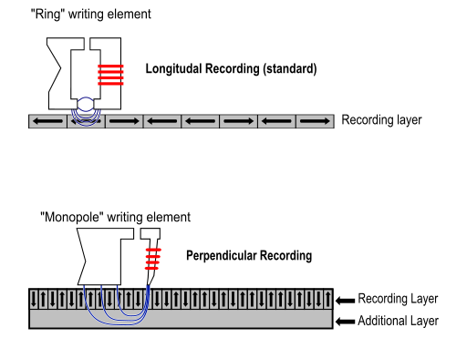
Magnetic Data Recording
Estimated data density limits:
Longitudinal:
100-200 Gb/sq. in
Perpendicular:
1000 Gb/sq. in
Luca Cassioli, Public Domain

Slide 5
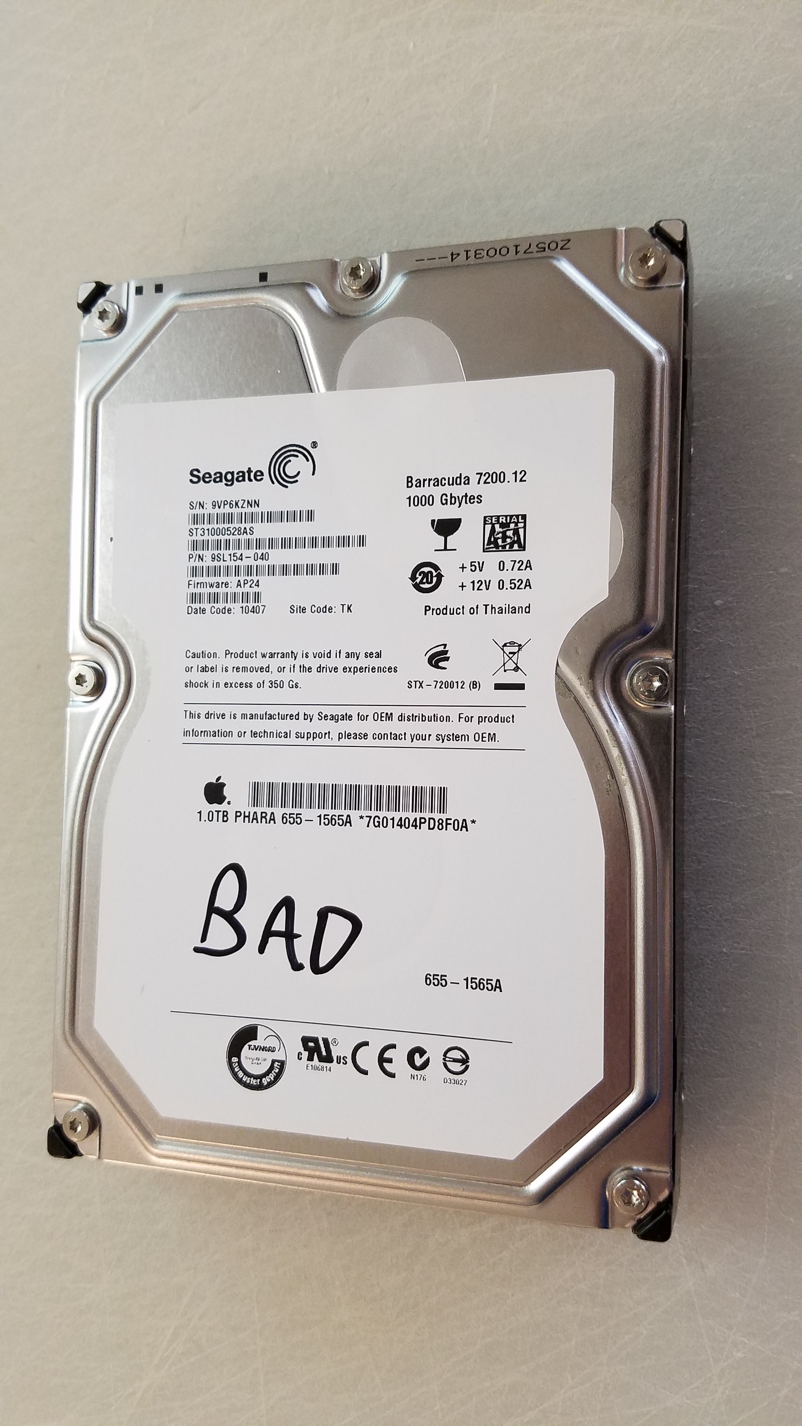
HDD Guts
Our sample drive is:
Seagate OEM made for Apple
1 TB (1000 GB)
7200 RPM

Slide 6
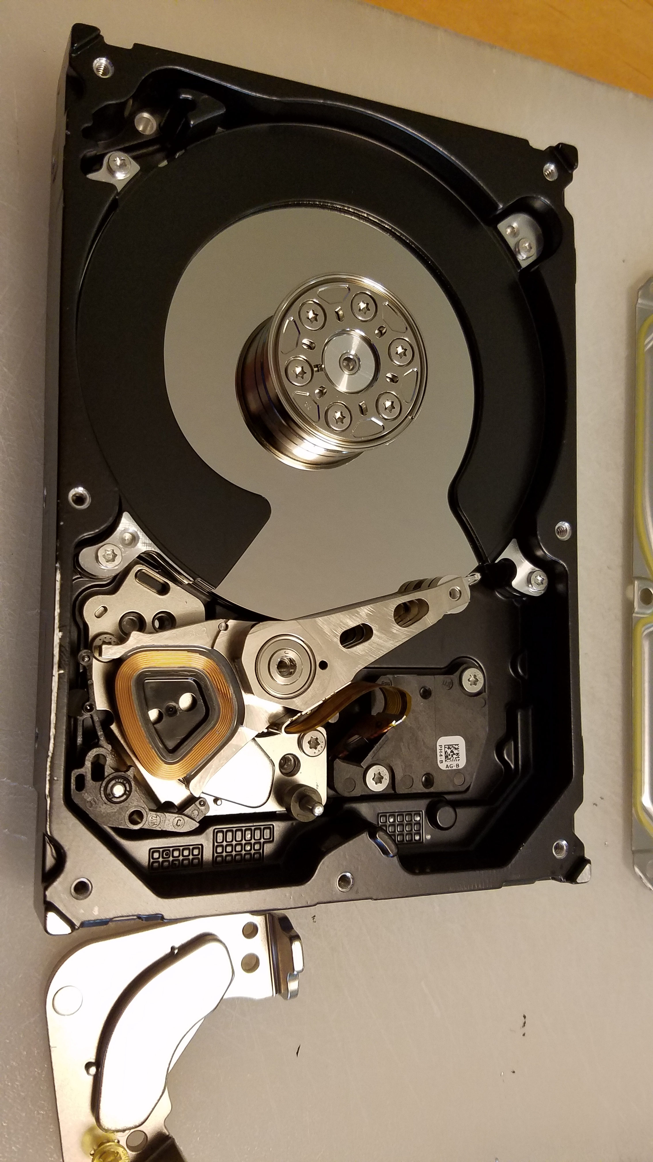
HDD Pictures
CNC-milled aluminum frame
Read/Write Heads (stacked)
Actuator and head control cable
Spindle & motor
Armature limit pins
Armature
Very strong magnets
Platters (stacked)
Voice coil actuator

Slide 7
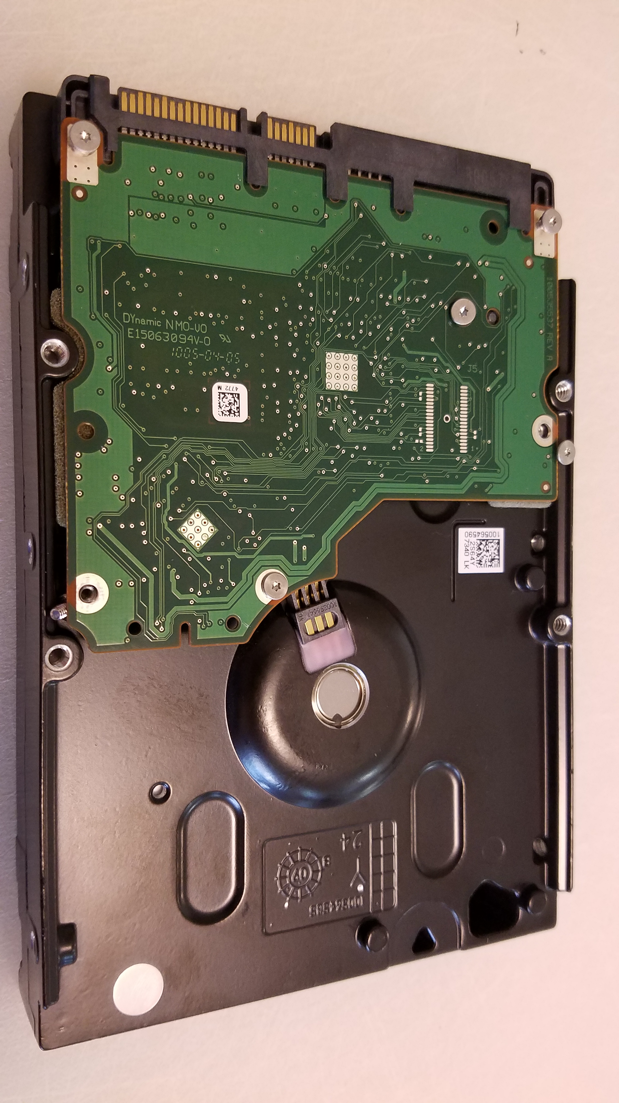
Drive control board
Platter motor and spindle
SATA data connector
SATA power connector

Slide 8
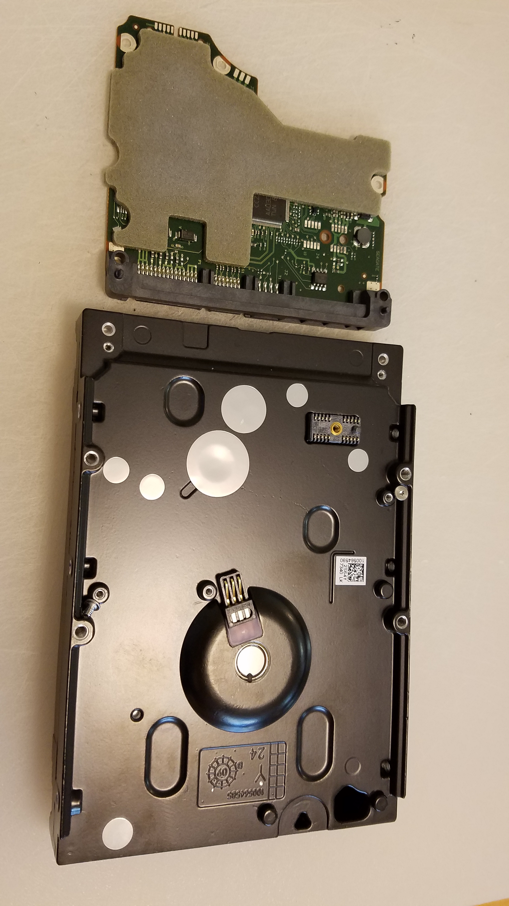
Standardized mounting screw holes
Standardized mounting screw holes

Slide 9
Solid-State Drives
A Solid-state drive (SSD) stores data on flash memory
Since any data cell can be accessed in fixed time, the seek speed is constant; reading any file, from any previous internal state, takes the same amount of time
Read and write times are (far) faster than HDDs
No moving parts, much lighter, smaller, not as shock sensitive, silent, can operate in vacuums, can be moved while being in use, uses generally less power, not susceptible to magnetic fields…
… but much more expensive

Slide 10
Form Factors
The names of the form factors come from the size of the platters
SSDs look the same, but don’t have the obvious platter spindle
“3.5 inch”
4” x 1” x 5.75”
aka Desktop

Slide 11
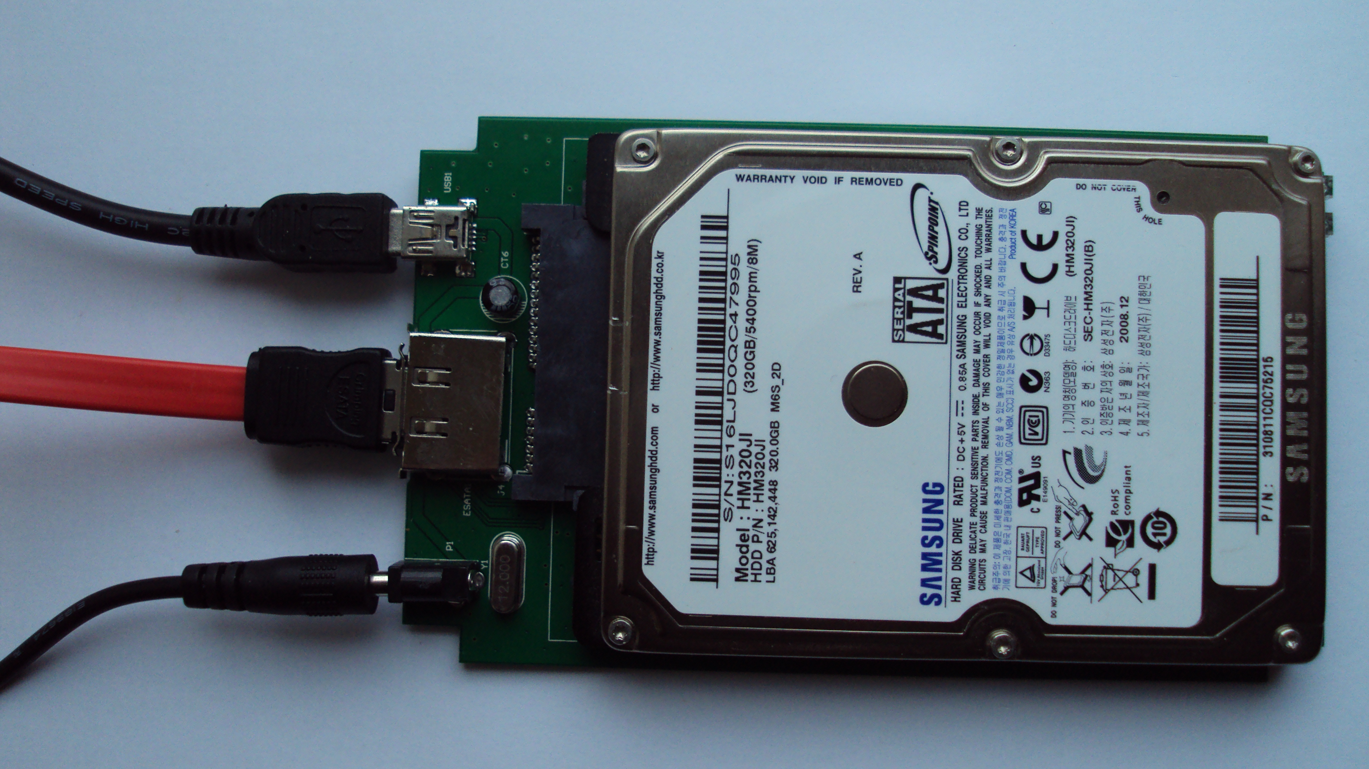
Form Factors
“2.5 inch” :: 2.75” x 0.275-0.75” x 3.945” :: aka Laptop
External hard drive enclosure circuit board
SATA connector
highwycombe,
CC BY-SA 3.0

Slide 12
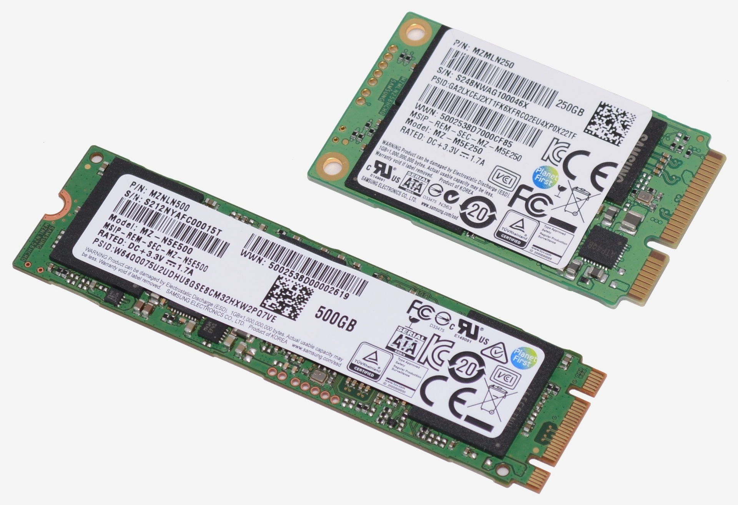
Form Factors
mSATA (precursor to M.2) 250GB SSD
M.2 is a case-less, PCB board only-standard that supports widths from 12 to 30mm, and lengths from 30 to 110mm
Hardware is built to accept one or more of these form factors
M.2 500GB SSD
AhmedAtmani
CC BY-SA 4.0

Slide 13
Failures
HDDs typically fail because of mechanical degradation of the magnetic substrate (possibly from a head crash), spindle motor failure, power component failure, or physical shock
SSDs typically fail because of power component failure, or too many erase operations on too many blocks over the lifetime of the drive
Algorithms (TRIM, wear leveling) spread out the operations, periodically moving data to less-used areas of the drive, to prevent one area from becoming over-used too soon
Expected life-times of all types of constant-use drives are difficult to estimate; around 2-9% of all drives fail per year during the first three years
Most manufacturers typically set consumer-grade drive warranties at (only) 3-5 years!

Slide 14
Partitions, Tables, and Volumes
Hard drives are logically organized as follows:
Partition: A designated, specific area of a drive, managed as a specific physical entity by the OS
File System: A system of organizing the representation (naming), addressing, metadata, and storage of files and folders within a partition, including integrity features, permissions/security, and size limits (can be different for each partition)
Volume: A file storage location inside a file system, consisting of a root directory in which all files and directories are hierarchically found
Multiple volumes can be created inside a partition
Mount Point: the particular folder inside the booted operating system where a volume’s files can be found
Volumes can be mounted inside an existing volume, causing the new volume to have a non-root filepath from the perspective of the other volumes
How about some examples?

Slide 15
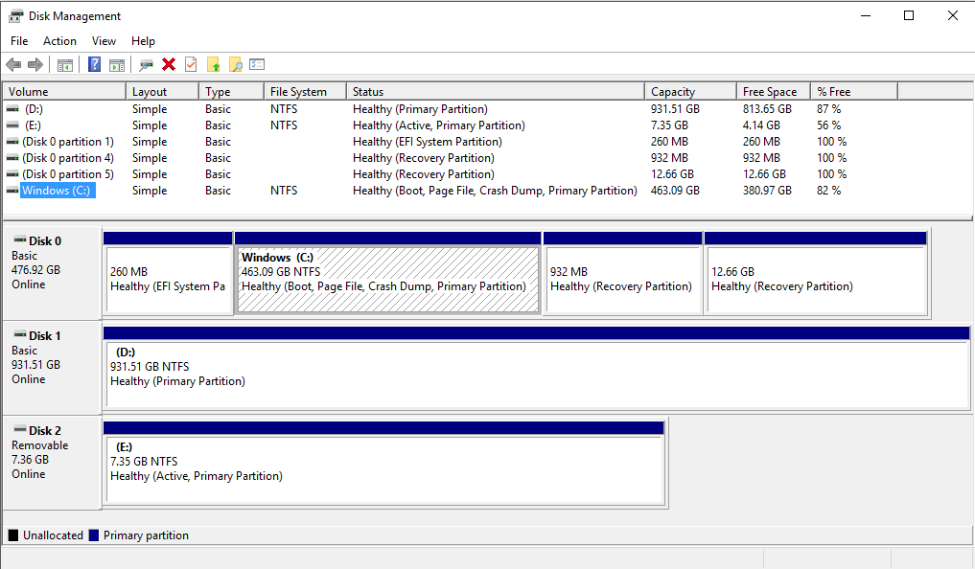
Windows 10 Disk Management tool in bare-metal OS install (ie normal)
Slide showing Windows drives and a Linux mount point
EFI Boot partition: What the UEFI system in the MOBO firmware uses to start your primary OS
3 Drives (2 HDD, one flash)
6 partitions (all but one unlabeled)
3 volumes

Slide 16
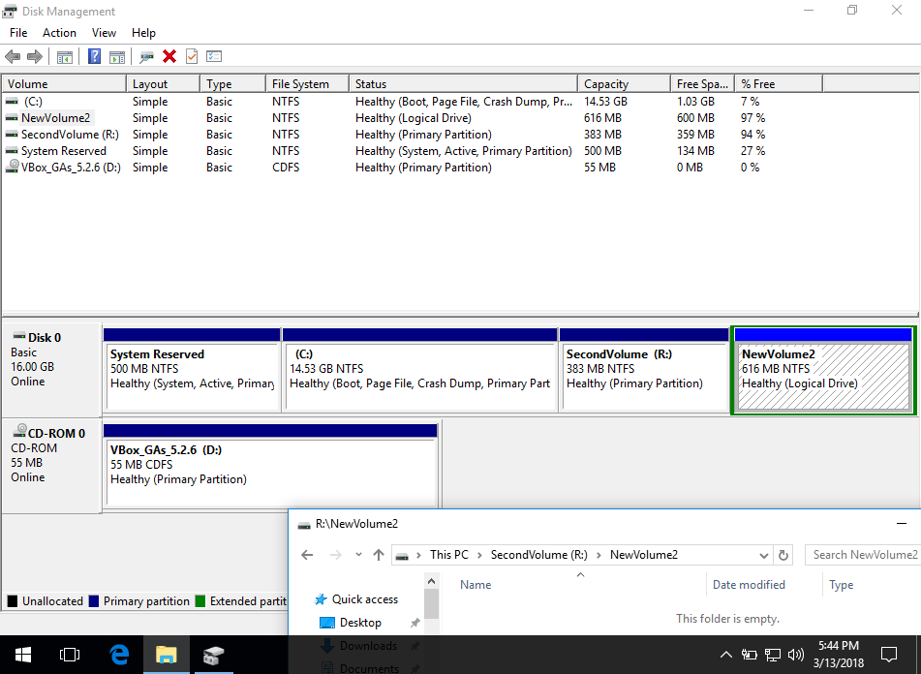
Windows 10 Disk Management tool in VM
Unlabeled partition with volume “C:”
Volume “R:” on partition “SecondVolume”
Volume named “NewVolume2” inside volume “R:” on partition SecondVolume

Slide 17
Identifying Linux Mount Points and Volumes
$ cat /proc/mounts | grep "stak/users"
128.193.40.232:/stak_users/data /nfs/stak/users nfs rw,nosuid,relatime,vers=3,rsize=262144,wsize=262144,namlen=255,hard,proto=tcp,port=2054,timeo=600,retrans=2,sec=sys,mountaddr=128.193.40.232,mountvers=3,mountport=5004,mountproto=tcp,local_lock=none,addr=128.193.40.232 0 0
$ lsblk
NAME MAJ:MIN RM SIZE RO TYPE MOUNTPOINT
sda 8:0 0 100G 0 disk
└─sda1 8:1 0 700M 0 part /boot
sdb 8:16 0 5.6T 0 disk
└─sdb1 8:17 0 5.6T 0 part
├─vg_el7-lv_root 253:0 0 2G 0 lvm /
├─vg_el7-lv_swap 253:1 0 31.4G 0 lvm [SWAP]
├─vg_el7-lv_usr 253:2 0 20G 0 lvm /usr
├─vg_el7-lv_scratch 253:3 0 5.6T 0 lvm /scratch
├─vg_el7-lv_private 253:4 0 1G 0 lvm /private
├─vg_el7-lv_var 253:5 0 8G 0 lvm /var
└─vg_el7-lv_tmp 253:6 0 8G 0 lvm /tmp
Types:
disk = drive
part = partition
lvm = Logical Volume Manager, a virtual partition aka volume
These volumes all have mountpoints in /

Slide 18
Sectors and Clusters
Hard drive platter
Sectors are the minimum storage unit of a drive, and have been various sizes; today usually 4,096 bytes (the Advanced Format)
A cluster (aka allocation unit) is the smallest amount of space that the file system will use to store a file
The size of a cluster is specified when the drive is formatted
A drive formatted with 4KB clusters (1 sector) will use an entire 4K cluster for a 10-byte file; the wasted space is called slack space
A larger cluster size reduces fragmentation, but increases slack space
Track
Cluster (of sectors)
Sector

Slide 19
Sectors and Clusters
Hard drive platter
Clusters do not have to be physically contiguous to still be logically contiguous
A track boundary might be in the middle of a cluster
Here:
4,096 byte sectors
20,480 byte clusters
65,636 byte tracks

Slide 20
Fragmentation
Hard drive platter
Files that are stored on a disk can become fragmented over time, causing increased latency to read and write operations, due to waiting for the platter to rotate to the read/write heads
For this example:
4,096 byte sectors
8,192 byte clusters
65,636 byte tracks
Track
Cluster
Sector

Slide 21
Fragmentation
Hard drive platter
File 1
Files that are stored on a disk can become fragmented over time, causing increased latency to read and write operations, due to waiting for the platter to rotate to the read/write heads
For this example:
4,096 byte sectors
8,192 byte clusters
65,636 byte tracks

Slide 22
Fragmentation
Hard drive platter
File 1 expands
Files that are stored on a disk can become fragmented over time, causing increased latency to read and write operations, due to waiting for the platter to rotate to the read/write heads
For this example:
4,096 byte sectors
8,192 byte clusters
65,636 byte tracks

Slide 23
Fragmentation
Hard drive platter
File 2 added
Files that are stored on a disk can become fragmented over time, causing increased latency to read and write operations, due to waiting for the platter to rotate to the read/write heads
For this example:
4,096 byte sectors
8,192 byte clusters
65,636 byte tracks

Slide 24
Fragmentation
Hard drive platter
Files that are stored on a disk can become fragmented over time, causing increased latency to read and write operations, due to waiting for the platter to rotate to the read/write heads
For this example:
4,096 byte sectors
8,192 byte clusters
65,636 byte tracks
File 3 added

Slide 25
Fragmentation
Hard drive platter
Files that are stored on a disk can become fragmented over time, causing increased latency to read and write operations, due to waiting for the platter to rotate to the read/write heads
For this example:
4,096 byte sectors
8,192 byte clusters
65,636 byte tracks
File 1 expands, split into two fragments

Slide 26
Defragmentation
Hard drive platter
Defragmentation moves files into contiguous physical locations for faster read/write access
File 1 moved to new location

Slide 27
Defragmentation
Hard drive platter
Inner holes will also be compacted to both slow down fragmentation in the future, and position all files closer together for faster read/write access
File 2 moved to new location

Slide 28
Defragmentation Final Thoughts
SSDs do not need to be defragged: they fragment so slowly due to algorithms put in place to prevent this from happening, that it’s not worth the write use on the drive
When Windows “defrags” an SSD, it’s merely doing a more aggressive TRIM garbage collection on the drive
Starting with Windows 8, Windows automatically defrags HDDs on a schedule - right when you’re trying to do something important

Slide 29
Disk Formatting
Formatting a partition in Windows is done from File Explorer: Right-click on a lettered volume (which is on it’s own partition), select Format; can choose:
Capacity (possibly leaving some parts of the drive unformatted and not part of the primary partition)
File System (NTFS, FAT(32) exFAT, etc.)
Allocation Unit size (aka block/cluster: 4096, 8192, 16 KB, 32 KB, 64 KB)
A disk label or name: MUSIC
Formatting a partition in Linux allows the same choices:
$ mkfs -t ext3 -b 1024 -L MUSIC /dev/sda1

Slide 30
Blocks
The term block can refer to many things depending on context:
A sector on a disk
A chunk of data in a transmission, either specified because of a manual setting, or perhaps related to the amount of data handled at once by an underlying driver, software buffer, or hardware buffer
The amount of data a “block device” processes at once, which may or may not be related to the sector or cluster size on the disk it gets that data from; could be the amount specified in the previous bullet point
An arbitrarily-sized unit used to track file size in UNIX, e.g. 512 bytes
Logical block addressing (LBA) is the name of the scheme used to give every block/sector on a hard drive a single number (0, 1, 2, etc. ) regardless of its physical position

Slide 31
File Systems in More Detail
An OS cannot read a filesystem unless it has drivers to do so
Filesystems are frequently designed by OS developers to meet the needs of the OS
A Format is synonymous with File System

Slide 32
Drive Wiping
Deleting a file merely marks the area on the drive as free, but the data is still there: many tools can extract that data
Even formatting the drive may not be enough!
Data can be securely deleted from a HDD only by writing data over the entire drive, but are you sure you’ve gotten the entire drive?
Despite reports to the contrary, files that have been overwritten cannot be read from an HDD, even with Magnetic Force Microscopy
SSDs occasionally have bugs in their delete/wipe commands that leave data intact
The only sure way to wipe is to destroy the platters or memory chips: shredding, drills, hammers, disassembly and big magnets, etc.

Slide 33
Conclusion + HDD Speaker!
Understanding the details behind file systems and disk drive management allows you to create storage areas that meet the specified requirements
Examples and standard file location descriptions coming next week
Laptop to amp to hard drive = speaker!

